Slide 1
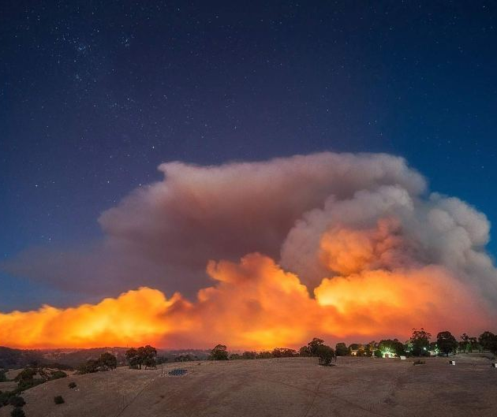



▌Coupling ACCESS to an empirical fire model
^{ACCESS Science Day 2019}
Harvey Ye*, Mika Peace* and Jeff Kepert*
*Bureau of Meteorology and Bushfire and Natural Hazards CRC
^{@bnhcrc}
^{@bnhcrc}
Notes:
Update with your own Facebook and Twitter handles

Slide 2
▌Motivation
Fire-atmosphere interactions
Energy released by a fire changes the surrounding atmosphere
Mika has run coupled fire-atmosphere WRF simulations. Coupling was essential to capture realistic firespread.
Surface-based approaches to fire prediction with linear assumptions have limitations
Understand dynamical processes
Strong support from fire agencies
Improved capability and accuracy for fire prediction ⇨ better fire managememt

Slide 3
▌System Development
The original code was developed in Melbourne and Monash Universities for Black Saturday simulations (on UMUI)
Basic structure:
4 nests: 4 km ⇨ 1 km ⇨ 300 m ⇨ 100 m
Forecast surface
parameters
UM
Atmosphere
model
Fire
spread
model
Calculated heat and moisture fluxes
Fire coupling turned on

Slide 4
▌Challenges
UM atmosphere model crashes when the heat flux values are large
Required a lot of tweaking on the UM settings of Subgrid Turbulence and Boundary Layer, with help from many model experts.
The current setting seems to be stable enough, enabling the first 24-hour simulation of the Waroona Fire.
Much to learn about the interface with the UM model, especially in the context of MPI and model restarting/cycling

Slide 5
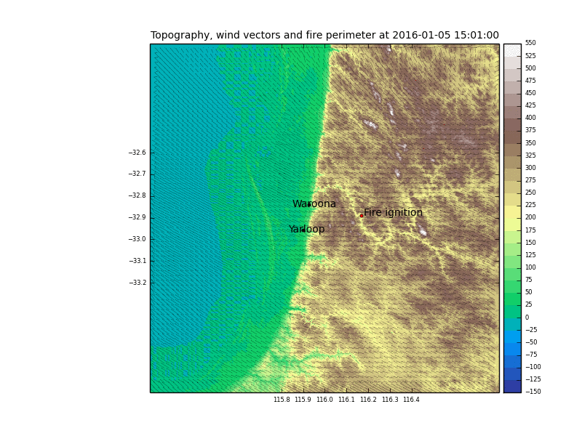
▌Latest results

